Slide 1
Data and Web Technique Movie news Web Feed Aggregator By Aravinda Baliga B (549886) Web Engineering SS-2019
01.07.2019
1

Slide 2
Contents
Introduction to Web Feed
Application workflow
Technologies utilized
References
01.07.2019
2

Slide 3
Web Feed
It is the website or the providers contents in the XML format.
Your favorite contents will be delivered to you automatically.
Two major types of web feeds are RSS and ATOM.
Aggregation of data from various sources
01.07.2019
3

Slide 4
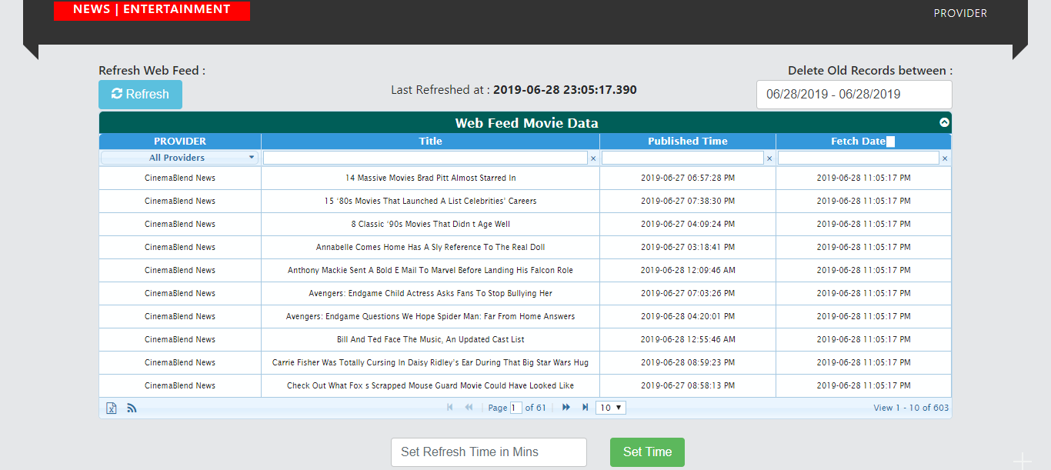
Application workflow : Web feed data view
01.07.2019
4

Slide 5
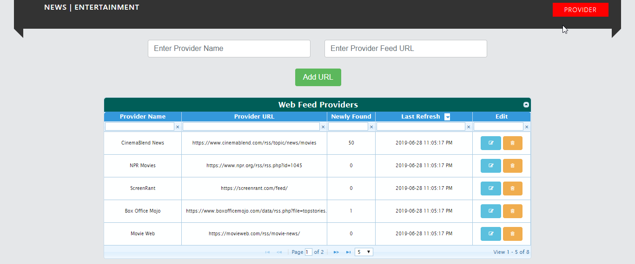
Application workflow : Providers view
01.07.2019
5

Slide 6







Technologies utilized:
Front End Backend Database
01.07.2019
6

Slide 7
References:
https://www.tutorialspoint.com/rss/what-is-rss.htm
https://perishablepress.com/an-easy-introduction-to-web-feeds/
https://www.w3schools.com/xml/xml_rss.asp
https://www.xul.fr/en-xml-rss.html
https://computer.howstuffworks.com/internet/basics/rss.htm
https://rss.softwaregarden.com/aboutrss.html
https://www.tutorialspoint.com/rss/what-is-atom.htm
https://www.ibm.com/support/knowledgecenter/en/SSGMCP_5.2.0/com.ibm.cics.ts.internet.doc/topics/dfhtl_atom_whatis.html
https://www.tutorialspoint.com/rss/rss-advantages.htm
https://stackoverflow.com/
https://api.rss2json.com/v1/api.json
01.07.2019
7

Slide 8
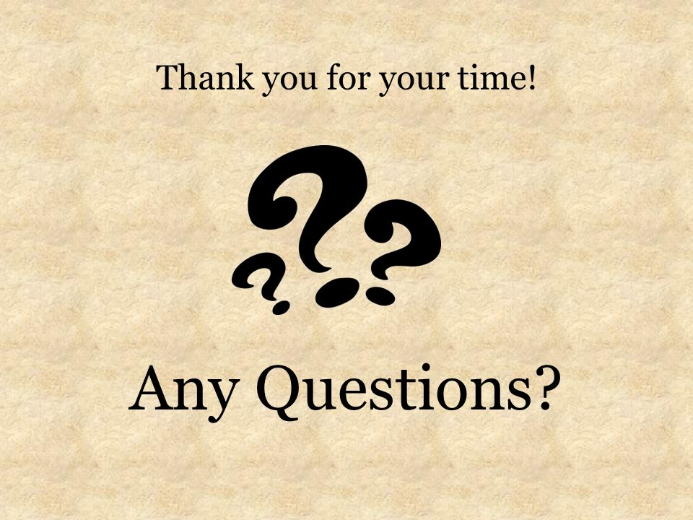
01.07.2019
8

